Slide 1
IFS FSM Support Process
Lee Pinchbeck
FSM SME Lead

Slide 2
IFS FSM Raising a Support Case
This guide is designed to assist you in making sure that all information and data is collated before raising a support case for FSM. This will ensure that your case is dealt with as quickly and efficiently as possible.
Run the PowerPoint as a slide show and then follow the steps in the process flow. If you need further information on a particular step, click the link in the process flow box and then click to return to the process flow.
back

Slide 3
IFS FSM Process Flow
FSM Problem
Search the IFS Community
Raise a support case Include detail
Replication Steps
Details of Replication Environment
FSM Client & Version
Expected Outcome
Error or Message Details
Upgrades & Changes From Baseline
Files to include
Screenshots
Run logs

Slide 4
IFS FSM IFS Community
Utilise the IFS Community by searching for your error message, issue or question for previous answers!
With over 5000 members & over 1,000 knowledge articles in the IFS X Knowledge Base, using this resource will:
Get you the answer without raising a support case
Reduce your waiting time for a response
Give you the opportunity to learn a lot more about your IFS product
Interact with other IFS Customers, Partners and IFS Employees
back

Slide 5
IFS FSM Screenshots
Always consider including screenshots, where possible, in your case logs. This helps direct those assisting direct to where you are seeing the issue and helps illustrate the issue you are describing.
Screenshots help avoid lost time due to misunderstandings as there are a lot of different areas of FSM that use similar functionality and therefore can be confused.
back

Slide 6
IFS FSM Exact Version & Environment
Please provide exact version of FSM the issue occurs in and whether the environment is Production, Test, or Development. Please also advise the client affected (Smart, Web, tech portal etc)
If the issue is present in more than one client or version please state this when logging the case. If unsure please confirm prior to logging if the issue is present in the other clients that you use.
Where do I find the version?
Once logged in to FSM Smart client, in the menu go to Help>About and this will show a pop up with all the version information required
back

Slide 7
IFS FSM Replication Steps
Always include the full steps you have taken to replicate the issue
Issues must be replicated prior to logging, preferably in a test environment
If there is a reason why replication is impossible please state this when logging in place of the replication steps but be aware that this can slow down a path to resolution of the issue
Steps should be clear and concise and able to be followed in any FSM environment
back

Slide 8
IFS FSM Issue Details
Please provide full details of the issue including:
First occurrence
Recent changes in the system (upgrade, patches, configuration changes etc)
What you were trying to do
Why you were trying to do it
What stopped you from trying to complete the task
Number of users affected
What areas of FSM are affected
Details of any errors or messages
The more detail provided, the faster your issue can be investigated and resolved.
back

Slide 9
IFS FSM Replication Environment
Include details of all environments where the issue has been confirmed
This should include a second environment to confirm the issue is not specific to one environment and can be replicated. Ideally this would be a baseline environment to rule out specific configuration or customisation.
Details as to how the environments can be accessed.
back

Slide 10
IFS FSM Expected Outcome
When raising an issue it is a good idea to include what you expected to occur or what end result you were trying to get to.
This then helps make sure that any workaround or fix will be appropriate in achieving this for you.
back

Slide 11
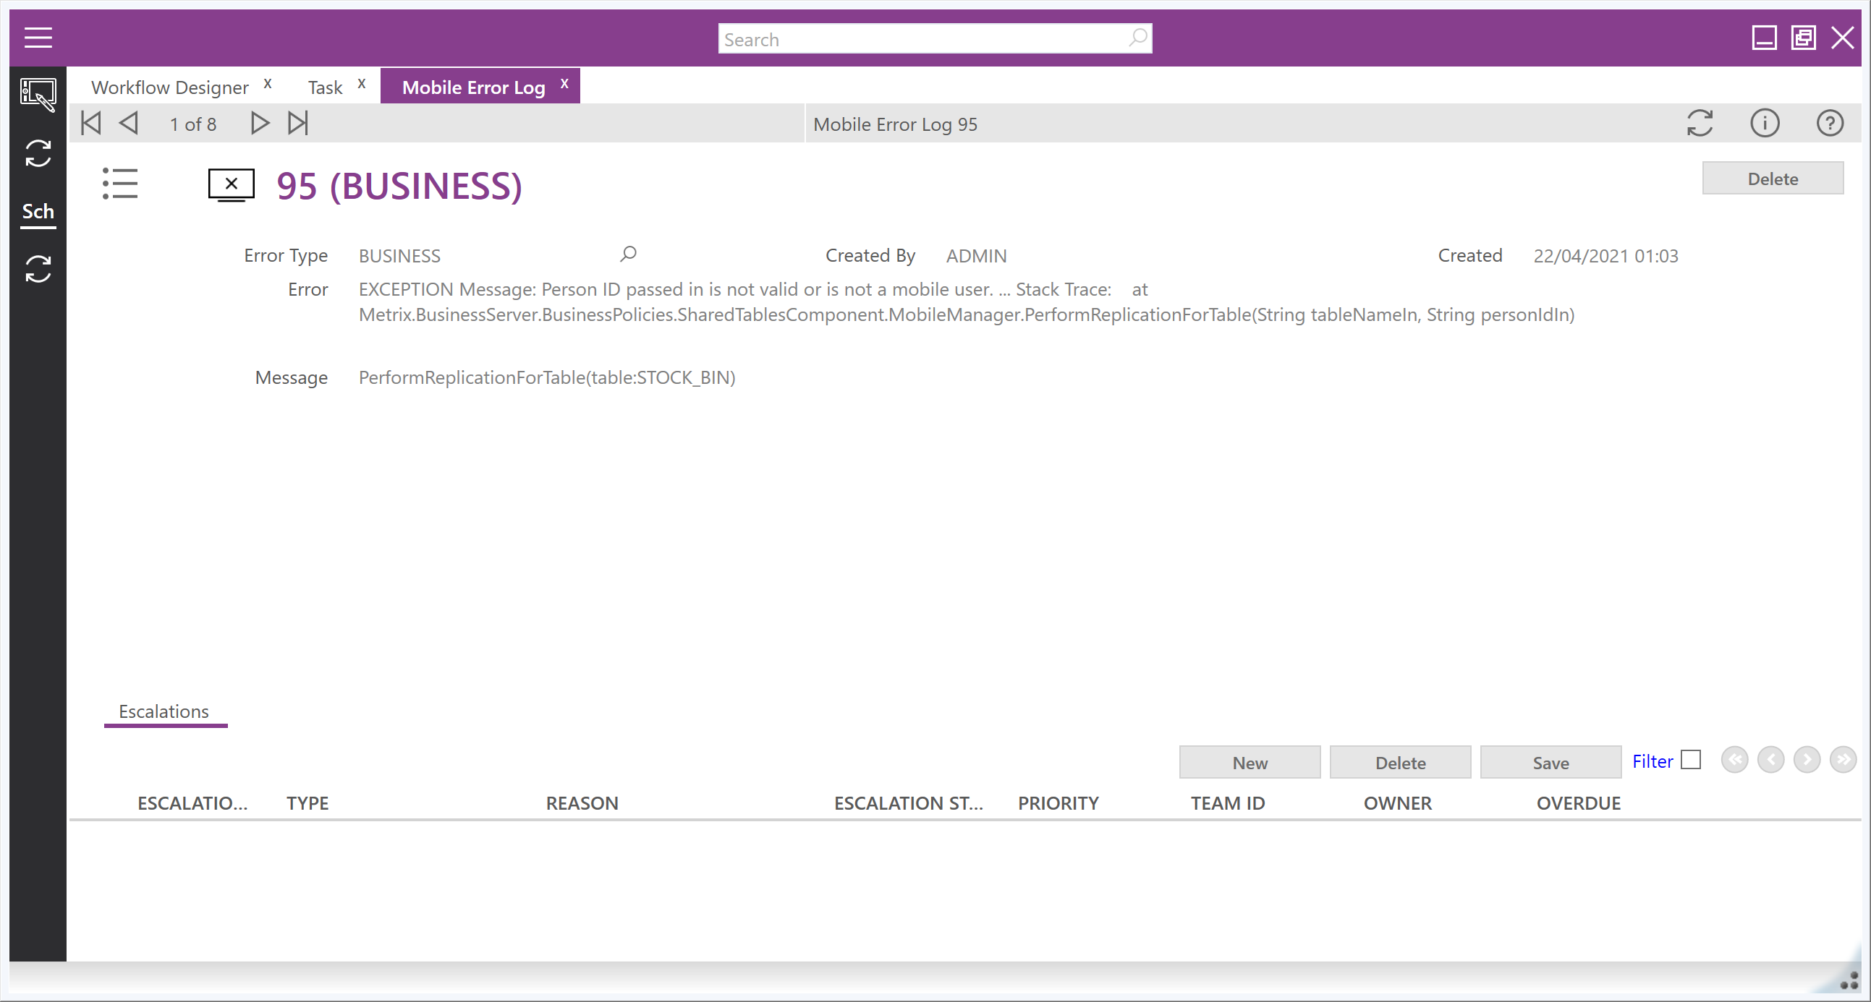
IFS FSM Error or Message Details
It is always important to include any errors or messages you have encountered during the issue you are logging. These help demonstrate what the system is having an issue processing
Uploading the error or message as a screenshot will help avoid mistranslation of the text
If there is an option to expand for more details please do this and also provide what is shown as this is often where the technical information is contained that will help pinpoint the cause.
If the error was missed, some are tracked with the various logs in FSM so check there for a copy of the error/message
back

Slide 12
IFS FSM Upgrade or Changes to Baseline
If you have recently undergone an upgrade, please include this information as well as which version you have moved from.
If you have a case number for the upgrade, please include this
If you have any scripts, business rules, sync rules or any other configurations that are not present in the out of the box software in the area the issue occurs please advise of these when logging
Enough detail of these changes will need to be provided to allow someone to recreate them in any environment to allow replication of the issue and rule out the configuration/customisations changes
back

Slide 13
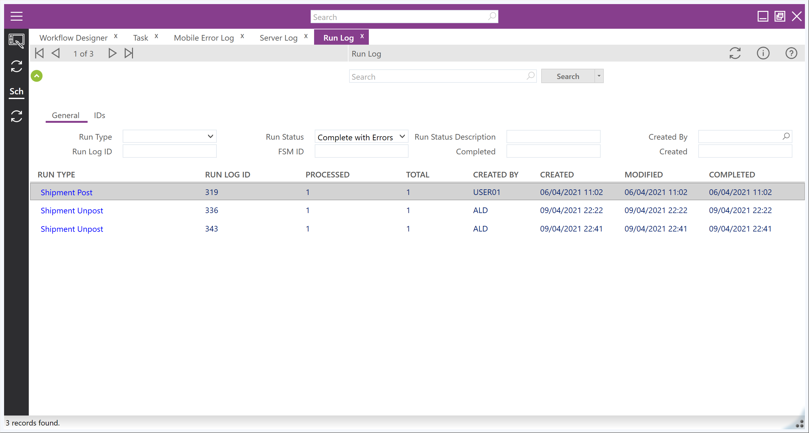
IFS FSM Run Logs
If the issue relates to an error or a background process please check the logs prior to raising a case to see if these were tracked there
Please include a copy of the log content if relevant when logging the case
The run logs can be filtered to find just errored logs which may assist in locating the relevant issue
Alternatively you can filter by the type of run if you know what process was being performed at the time
back

Slide 14
IFS FSM FSM 6.10
COMING SOON!!

Slide 15
Thank you!
#MOMENTOFSERVICE

