Slide 1

IFS PSO
Support Process
Philippa Lamerton
ACH Lead

Slide 2
IFS PSO
Raising a Support Case
    This guide is designed to assist you in making sure that all information and data is collated before raising a support case for PSO. This will ensure that your case is dealt with as quickly and efficiently as possible.
    Run the PowerPoint as a slide show and then follow the steps in the process flow. If you need further information on a particular step, click the link in the process flow box and then click to return to the process flow.
back

Slide 3

IFS PSO
Process Flow
PSO Problem
Search the IFS Community
Raise a support case Include detail
IFS CLOUD CUSTOMERS
ONLY
Any integrations with PSO
Exact version & environment
HTM version (if used)
Full issue details & test plan
Database & version
Time zone
PSO 6.7
Support Page
Files to include
PSO 6.7
Customers
PSO 6.7
Failed Audits &
Broadcast History
Saved schedule
Event logs
Input history
System parameters
ARP export (if used)
Any other files e.g. SLA Types

Slide 4
IFS PSO
Example PSO Problems
    Archive
    Realtime Snapshots aren't creating for customers who don’t have reporting license
    Snapshots don't contain input data for Distributed type datasets
    Appointment Booking
    Timeouts received while appointment booking
    Slots with higher offer values received later in the schedule
    FSM Integration
    When Task type is changed to a committed activity, it throws to exceptions in PSO
    FSM SSO users setup as PSO system users are getting disabled (These users then can't log into PSO)
    Scheduling
    Error messages in the event logs such as:
    ‘Object Reference cannot be set to instance of an object’
    “Error Reported During Optimization”
    UI issues
    Resource/Activity scheduling queries
    Advanced Resource Planner
    Unavailability added in Resource Planner not showing when returning to the planner
    Changes made to a particular shift in planner (e.g. max travel) are not saving
    When you load the resource planner, resource details are not showing
back

Slide 5

IFS PSO
IFS Community
Utilise the IFS Community by searching for your error message, issue or question for previous answers!
With over 5000 members & over 1,000 knowledge articles in the IFS X Knowledge Base, using this resource will:
    Get you the answer without raising a support case
    Reduce your waiting time for a response
    Give you the opportunity to learn a lot more about your IFS product
    Interact with other IFS Customers, Partners and IFS Employees
back

Slide 6


IFS PSO
Integrations
IFS FSM
IFS APPS
back

Slide 7

IFS PSO
Exact Version & Environment
Please provide the exact version of PSO the issue occurs in and whether the environment is Production, Test, or Development.
Supported versions:
    PSO 6. xx
    Where do I find the version?
    When logging into PSO the version is located on the bottom left as shown in the screen shot
back

Slide 8

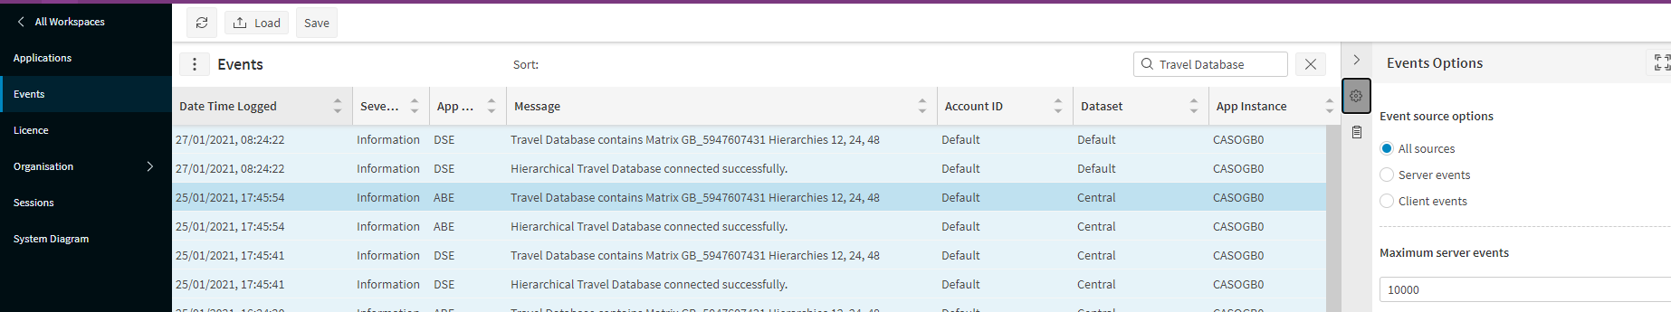
IFS PSO
HTM
    Please give the name & version of the HTM (Hierarchical Travel Matrix) if one is being used
    Search for this in the Event logs using ‘Travel Database’
    It may require a database administrator to check the matrix_descr & matrix_structure_version columns in the Matrix_Bounds table of the database.
back

Slide 9

IFS PSO
Issue Details
Please provide full details of the issue including:
    Resource name & ID
    Activity id
    Any client errors
    Problem occurring with step-by-step test plan
    Screen shots of the issue
    Database export may in some circumstances be required
    Any other information that can aid investigations
The more detail provided, the faster your issue can be investigated and resolved.
back

Slide 10

IFS PSO
Database and Version
Select from:
  Oracle – supported versions
    Oracle 19C - Oracle 19c Standard Edition 2 & Oracle 19c Enterprise Edition
    Oracle 12c R2 - Oracle 12.2.0.1 Standard Edition 2 & Oracle 12.2.0.1 Enterprise Edition
  SQL Server – supported versions
    Azure, 2014, 2016, 2017 & 2019
  SQL Azure – please also include whether this is IFS Cloud
back

Slide 11

IFS PSO
Time Zone
    Please give detail of the time zone of the PSO environment:
    Server
    Application - this is defined in the input data
back

Slide 12
IFS PSO
Saved Schedule
    A user can save the current live schedule by opening the ‘Schedules’ panel and using the ‘Save Current Schedule’ option. This will save the schedule into the system database.
    From here the user can also download the saved schedule if they have the permission ‘UserSchedulesDownload’. Alternatively, an administrative user can download the schedule from the Users screen in the Administration workspace.
    Finally, user saved schedules can be obtained using the installer – see the installation guide for details.
    PLEASE NOTE: it is also possible to save historical schedules.
    If the Schedule Archive is in use, a user can create, view and download Schedule snapshots. Otherwise, historical schedules can be viewed via the ‘History’ section of the Schedules panel, at least for the current day.
back

Slide 13
IFS PSO
Event Logs
    To save the events using the PSO Scheduling Workbench, log onto the Workbench as an administrator user and go to Events page within the Administration workspace.
    By default, the last 1000 events will be displayed, but this number can be increased, if necessary, to ensure that the events cover the time when the issue occurred. In the PSO Workbench, this option can be found by clicking on the three vertical dots next to the ‘Events’ title, and the maximum events can be changed in the events panel opened.
    The events can be saved using the ‘Save’ button, which is found in the top left of the screen for both workbenches. A saved event file can also be loaded for viewing using the ‘Load’ button.
    PLEASE NOTE: by, default events are only stored in the server for 7 days. This time limit is based on the parameter ‘SystemEventRetentionSeconds’.
    To save events using the event logs, log onto the server(s) on which the PSO components are running and open the Event Viewer. Each component writes to its own event log under the ‘Applications and Services Logs’ section of the event viewer. Click on a particular log to open it and use ‘Save All Events As…’ in the action menu. Events saved in the default .evtx format can be reopened using the event viewer, though it’s also possible to save as either csv or text file.
back

Slide 14
IFS PSO
Input History
    To obtain this, in the PSO Workbench, go to the ‘Audit’ screen within the ‘Archive’ workspace. Find a relevant ‘Schedule’ saved from the time that the issue occurred, click on the row and click the ‘Download Audit Trail’ button in the top right of the screen.
    This will download the selected Audit data and all the relevant Audit data before it (the complete Audit trail) as individual XML files contained within a zip file. If an audit with update type of CHANGE is selected, input files will be downloaded. If an audit with update type of PLAN_CHANGE is selected, both input and output files will be downloaded.
    Alternatively, the input history can be obtained from the ‘Input History’ folder on the server where the Schedule Input Manager is installed.
    By default, this will be ‘C:\IFS\Scheduling\Input History’. It’s important that the files sent include the previous initial load file and all change files from this file up until the time that the issue occurred. Also, be aware that if the input manager is installed on multiple servers, then the input history from each server will be required.
back

Slide 15
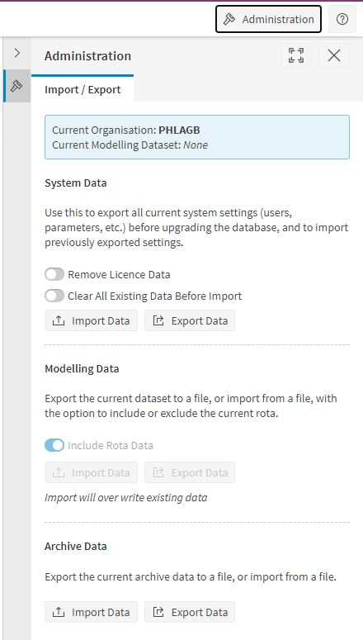
IFS PSO
System Parameters
    System settings can be exported either via the Scheduling Workbench or via the installer.
    In the PSO Workbench, go to any screen in the Administration workspace under the Organisation menu, and click on the ‘Administration’ button in the top right corner of the screen (visible if the user is an administrator) to open the ‘Import/Export’ options. Then click ‘Export Data’.
    See the installation guide for details of using the installer, this is found in the documentation folder contained in your PSO release.
back

Slide 16
IFS PSO
ARP Export
    ARP data can be exported either via the Scheduling Workbench or via the installer.
    On the PSO Workbench, from any Planning workspace screen an ‘Administration’ button should be available in the top ribbon provided the user is an administrator. Click this to open the administration panel, and then click ‘Export’, ensuring that any rota data is included.
    See the installation guide for details of using the installer, this is found in the documentation folder contained in your PSO release.
back

Slide 17
IFS PSO
Additional Data
    Sometimes the Input_Reference element in a customer’s initial load file will include a ‘data_path’ attribute which refers to a secondary xml file, usually containing dispatch rules or SLA Types for example. If this is the case, please ensure that these additional files are retrieved.
    Occasionally additional information may be required when diagnosing an issue.
    Common examples:
    The ‘Application’ and ‘System’ event logs from the servers
    Details of errors produced on the Client
    In the HTML5 client these appear in the Events Screen
    A snapshot of one of more database tables
    A full backup of the database(s).
back

Slide 18

IFS PSO
IFS CLOUD
    Please provide full details of the issue including the following if applicable:
    Problem occurring with step-by-step test plan
    Environment issue occurs on – Prod or Test
    Resource name & ID
    Activity ID
    Any client errors observed
    Screen shots
    Any other information to aid investigations
  IFS Support will request all other details (e.g. version, HTM version/matrix, Audit Trail, System Parameters, ARP etc.) from the IFS Cloud team.
back

Slide 19
IFS PSO
PSO 6.7 Support Page
The Support page allows the user to select specific data to be exported from the workbench. The user is able to export WISE investigations, system data, both scheduling and modelling audit trails, an ARP export of each modelling dataset, existing saved schedules and the current schedule.
    Enable Scheduling Workbench permission AdminSupportView to view page.
back

Slide 20
IFS PSO
PSO 6.7 Audit Failed Updates & Broadcast History
The Failed Audits screen shows a list of Audits that have failed and why it was rejected by the Scheduling Input Manager (SIM). The user is also able to view or download the audit data.
Broadcast History
All broadcasts are saved and displayed on the scheduling workbench.
back

Slide 21
Thank you!
#MOMENTOFSERVICE

