Slide 1
TROUBLESHOOTING SSO AUTHENTICATION​
Guide for diagnosing SSO Authentication ​ issues with IFS Applications (IFS9/IFS10)
Yasas Kasthuriarachchi
Lead Software Engineer and Subject Matter Expert
Advanced Competence Hub Customer Service Experience
2021 - 08 - 31

Slide 2
Resource Keys
Return to Home Page
Move to Previous Slide
Click on the Appropriate Button
Move to Next Slide

Slide 3
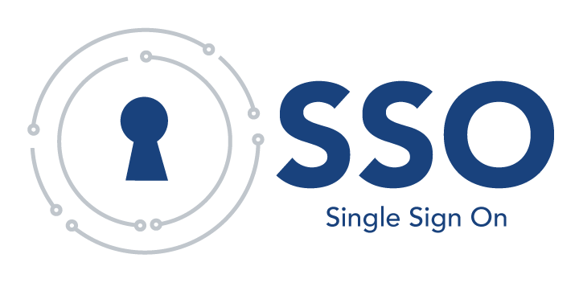
IFS Application version
Home Page
Which version of IFS Application are you using?
IFSAPP9
IFSAPP10

Slide 4
IFS APP9
Home

Slide 5
1.0
Previous Slide
Home
IFS APP9
Did SSO work previously in this environment?
YES
NO

Slide 6
1.1
Previous Slide
Home
IFS APP9
Did you refer to IFS Documentation covering the SSO integration
YES
Refer following in the IFS APP9 Technical Documentation
Deploy IFS Applications Middle Tier (16-19 sections)
Configure Single Sign On - SSO
NO
Notes:
https://wit.ifsworld.com/f1docs/apps9/Foundation1/020_installation/020_Installing_Fresh_System/040_Installing_IFS_Applications/030_deploy_middle_tier/default.htm
https://wit.ifsworld.com/f1docs/apps9/Foundation1/020_installation/400_installation_options/003_security/010_sso_middleware_server/default.htm

Slide 7
1.2
Previous Slide
Home
IFS APP9
After verifying the SSO installation document and trying out the steps; does the issue still re-create?
YES
NO

Slide 8
1.3
Previous Slide
Home
IFS APP9
Has an IFS / Project Consultant reviewed this SSO implementation issue? (since there is an issue with implementation; where SSO was never verified)
YES
You need to review this with an IFS / Project Consultant who was associated with implementation of your Environment’s SSO and get their guidance as an initial step
NO

Slide 9
1.4
Previous Slide
Home
IFS APP9
Is the recommendation of the Consultant, to raise this with IFS Support or R&D?
YES
You need to review this with an IFS / Project Consultant who was associated with implementation of your Environment’s SSO and get their guidance / recommendations first
NO

Slide 10
2.0
Previous Slide
Home
IFS APP9
Has this been occurring for a all users?
YES
This indicates a User Group issue / incorrect mapping or issue with user setup. Hence check if the specific user is in the correct IFS LDAP Group. After verifying that user is present in the correct group and if issue persist click here
NO

Slide 11
3.0
Previous Slide
Home
IFS APP9
Are there any duplicated SPNs in the Active Directory?
YES
Make sure that no duplicate SPNs are registered for the machines in your cluster. A SPN mapped to multiple (service) accounts will make WIA to fail and the client will most likely get a HTTP Error 401 Unauthorized. Use the command setspn -X -F to list duplicates in your Active Directory. Refer Create Keytab File > Verify Service Principal Names in IFS Technical Documentation for more details.
NO

Slide 12
4.0
Previous Slide
Home
IFS APP9
Are you using a single Active Directory?
YES
NO
The SSO integration is only certificated against a single Active Directory. Hence please setup a single Active Directory setup! You (customer / partner) need to do this internally

Slide 13
5.0
Previous Slide
Home
IFS APP9
Does LDAP Authentication work?
YES
It is a mandatory requirement to have LDAP working. You (customer) need to ensure that Customer LDAP configuration is working successfully in the environment prior to verifying SSO; hence this is a pre-requisite check to be carried out internally by customer
NO

Slide 14
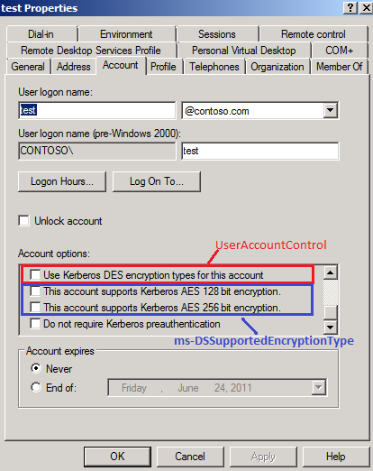
6.0
Previous Slide
Home
IFS APP9
Verify if the checkbox “This account supports Kerberos AES 256-bit encryption”, in the SSO Service Account properties is left unticked?
YES
NO
Checkbox “This account supports Kerberos AES 256-bit
encryption”, in the SSO Service Account properties MUST be unticked

Slide 15
7.0
Previous Slide
Home
IFS APP9
Is the keytab file successfully verified using kinit?
YES
NO
Refer here or IFSAPP9 Technical Documentation and create the keytab file correctly

Slide 16
8.0
Previous Slide
Home
IFS APP9
Are there any firewalls blocking the UDP and TCP ports used by the Kerberos protocol and between the Application Server and the Active Directory, used by LDAP?
YES
Ensure that firewalls are not blocking the UDP / TCP ports and between the Application Server and the Active Directory, used by LDAP
NO

Slide 17
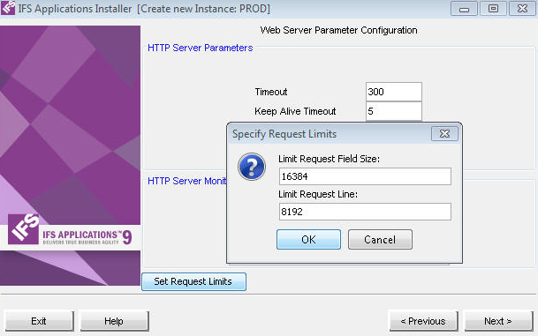
9.0
Previous Slide
Home
IFS APP9
Are loggings of HTTP Status Code “400 – Bad request” present in any access.log?
The default value of the ‘Limit Request Field Size’ parameter should be increased. Refer picture below. As an initial step you could set the Limit Request Field Size parameter to the double of the default value. However, it is NOT recommended to set any of these values to contrasting high figures; hence adjust gradually based on the situation.
YES
NO

Slide 18
10.0
Previous Slide
Home
IFS APP9
Are there any circular nested LDAP groups in the Active Directory?
YES
This is likely to be an issue with the LDAP user configuration hence please verify this with an internal system administrator
NO

Slide 19
11.0
Previous Slide
Home
IFS APP9
Is the client sending a Kerberos ticket?
Determine above based on log indications (enable debugging) / Sniff client traffic with Wireshark
YES
NO
Check the SPN as if it contains the correct naming. Refer to SPN verifications in IFS APP9 Technical Documentation
Notes:
Kerberos Client Authentication
https://docs.oracle.com/cd/E27515_01/common/tutorials/authn_kerberos_client.html

Slide 20
12.0
Previous Slide
Home
IFS APP9
Did you consult IFS Supported Platforms, section 3rd Party LDAP Server, for supported integrations with Active Directory?
YES
NO
Refer here on the IFS Supported Platforms and ensure that the system is supported for integrations with Active Directory
Notes:
https://community.ifs.com/support-documentation-195/ifs-applications-supported-platforms-4017

Slide 21
No Solution so far?
Previous Slide
Home
IFS APP9
Did you search in IFS Community?
Search in IFS Community
YES
NO
Search your specific issue using keywords including SSO and any error messages or log indications

Slide 22
No Solution so far?
Previous Slide
Home
IFS APP9
Did you post this issue in IFS Community?
Post in IFS Community
YES
NO
I want to raise a Support Case since this is urgent
Did you find a solution?
YES
NO
We would appreciate if you could post this issue in IFS Community with all the details / test plan and screenshots

Slide 23
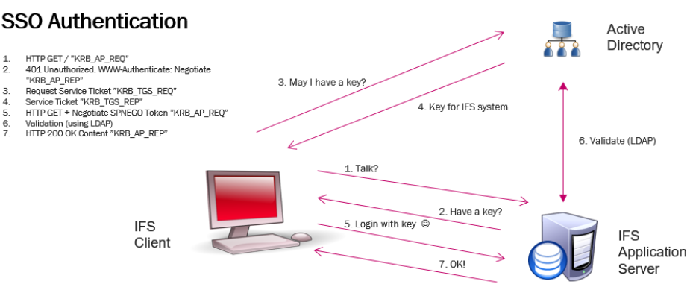
13.0
Raise a Support Case
Previous Slide
Home
IFS APP9
Provide following information with the support case
What are the configuration or installation (release/update) changes you have done prior to the occurrence of this issue?
What is the update level of the customer?
What are the Operating Systems and versions of the System where IFS Application Server and Active directory are installed?
Is a horizontal cluster, spanning over multiple machines, used?
What is the output of the command setspn -L <SSO Service Account>?
What is the output of the command klist -e -k FILE:<PATH TO KEYTAB FILE>? (klist resides in any Java jre/bin folder)?
Based on the output of klist, is the Key Type 17 (AES-128) or 23 (RC4-HMAC)?
In which step of the third-party protocol Kerberos do you think the problem occur (Refer image below 1-7)?
Attach following to the support case;
IFS Dump taken just after experiencing issue
A capture file taken on the Application Server, using WireShark etc.

Slide 24
IFS APP10
Home

Slide 25
1.0
Previous Slide
Home
IFS APP10
Did SSO work previously in this environment?
YES
NO

Slide 26
1.1
Previous Slide
Home
IFS APP9
Did you refer to IFS Documentation covering the SSO and ADFS integration
YES
Refer following in the IFS APP10 Technical Documentation
Achieving Single Sign-On behavior
Configure Active Directory Federation Services
NO

Slide 27
1.2
Previous Slide
Home
IFS APP10
After verifying the SSO installation document and trying out the steps; does the issue still re-create?
YES
NO

Slide 28
1.3
Previous Slide
Home
IFS APP9
Has an IFS / Project Consultant reviewed this SSO implementation issue? (since there is an issue with implementation; where SSO was never verified)
YES
You need to review this with an IFS / Project Consultant who was associated with implementation of your environment’s SSO and get their guidance as an initial step
NO

Slide 29
1.4
Previous Slide
Home
IFS APP9
Is the recommendation of the Consultant, to raise this with IFS Support or R&D?
YES
You need to review this with an IFS / Project Consultant who was associated with implementation of your environment’s SSO and get their guidance / recommendations first
NO

Slide 30
2.0
Previous Slide
Home
IFS APP10
Choose your SSO Implementation
SSO with ADFS
SSO with Azure AD

Slide 31
3.0
SSO with Azure AD
Previous Slide
Home
IFS APP10
Refer Achieving Single Sign-On behaviour > Single sign on with Azure Active Directory on IFS Technical Documentation for IFS APP10
Refer Azure Active Directory (Azure AD) scenario and Troubleshoot AD FS issues in Azure Active Directory in Microsoft Documentations.

Slide 32
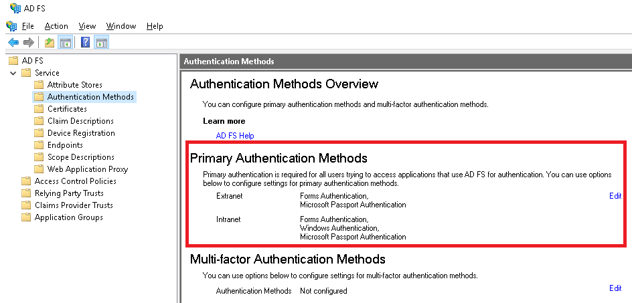
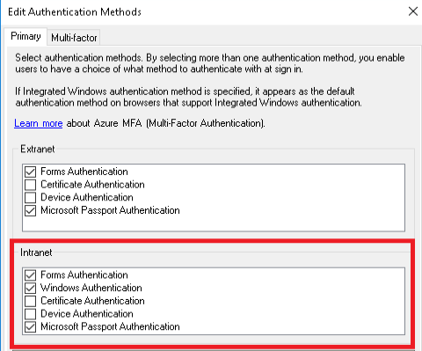
4.0
Previous Slide
Home
IFS APP10
In the ADFS management console Service > Authentication Methods > Primary Authentication Methods; are "Forms Authentication" and "Windows Authentication" check boxes ticked?
YES
NO
Ensure that under "Intranet" both "Forms Authentication" and "Windows Authentication" check boxes are selected (ticked)

Slide 33
5.0
Previous Slide
Home
IFS APP10
Is the UserAgent used by the client application defined in the ADFS Property 'WIASupportedUserAgents'
YES
Ensure that the UserAgent used by the client application is defined in the ADFS Property 'WIASupportedUserAgents’ In order to enable WIA for IFS Enterprise Explorer, UserAgent"Mozilla/4.0"needs to be added to this property. Also if you open up Aurena Web Client and Aurena B2B Client in Edge browser or Chrome browser the user agents"=~Windows\s*NT,*Edge"and"Chrome“ must be added to the list of allowed User Agents.
NO

Slide 34
6.0
Previous Slide
Home
IFS APP10
Is the ADFS property "ExtendedProtectionTokenCheckto" set to none?
YES
NO
Set the ADFS property "ExtendedProtectionTokenCheckto" to none. Restart the Active Directory Federation Services after changing this parameter at a suitable time to have the effect.

Slide 35
7.0
Previous Slide
Home
IFS APP10
Has this been occurring for a all users?
YES
This indicates a User Group issue / incorrect mapping or issue with user setup. Hence check if the specific user is in the correct IFS AD Group. After verifying that user is present in the correct group and issue persist click here.
NO

Slide 36
8.0
Previous Slide
Home
IFS APP10
Does this relate to Token lifecycle for third party apps
This is out of IFS support scope. Different apps implement the protocol differently and it is possible to get tokens that the IFS Middleware Server will accept using other mechanisms than the ones used by IFS clients. A common way to handle ADFS is to use a Microsoft-provided library called ADAL, which exists in many languages and can produce acceptable tokens. In order to diagnose any related issues, Active Directory Federation Services site is recommended to understand the workings of ADFS.
YES
NO

Slide 37
9.0
Previous Slide
Home
IFS APP10
Is the issue only reproducible from outside of the company intranet?
Verify that this is not an issue relating to firewall or other network configurations. Here if the problem appears when connecting over the internet but not from inside the intranet or via VPN) this is a strong pointer to connectivity or TLS issues. If there are issues with TLS or connectivity, the first step is always to solve them first.
YES
NO

Slide 38
10.0
Previous Slide
Home
IFS APP10
Have you pressed the “Verify IDP TLS” button in the IFS MWS Admin Console and added the certificate to the trust store if missing?
YES
NO
Press the “Verify IDP TLS” button to check
Add the certificate to the trust store if missing

Slide 39
11.0
Previous Slide
Home
IFS APP10
Is ADFS event auditing enabled as per this page?
YES
NO
Enable ADFS event auditing according to this and troubleshoot as specified.
Notes:
Refer: https://docs.microsoft.com/en-us/windows-server/identity/ad-fs/troubleshooting/ad-fs-tshoot-logging

Slide 40
12.0
Previous Slide
Home
IFS APP10
Has an attempt been made to troubleshoot ADFS in any way as described in the ADFS documentation?
YES
NO
Refer to this and troubleshoot accordingly.
Notes:
1. https://docs.microsoft.com/en-us/windows-server/identity/ad-fs/troubleshooting/ad-fs-tshoot-overview
2. https://docs.microsoft.com/en-us/windows-server/identity/ad-fs/troubleshooting/ad-fs-tshoot-logging

Slide 41
13.0
Previous Slide
Home
IFS APP10
Can you see any sign of “invalid client authentication” or terms resembling to that in any logs in conjunction with a problem?
YES
Indication of a faulty configuration when ADFS is used. Verify that the client details are entered correctly in the Middleware Server Admin Console and that the client secret has not expired at the ADFS server.
NO

Slide 42
14.0
Previous Slide
Home
IFS APP10
Can you see any signs of error “the user specified does not appear to be an active user in the system” in the server logs
YES
Strongly indicate that the specified Directory ID for that user is wrong. Verify in Solution Manager that it has been set to the value that the Identity Provider sends (UserPrincipalName in the AD case).
NO

Slide 43
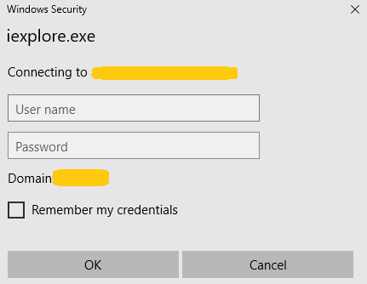
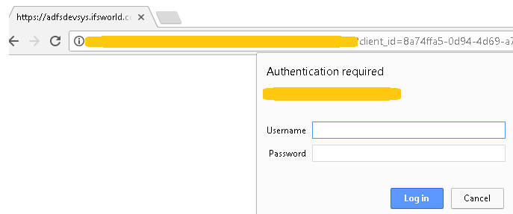
15.0
Previous Slide
Home
Do you get a Windows / Browser Security dialog requesting username and password?
IFS APP10
YES
Whitelist the URL used by the ADFS server and / or the Application server.
NO

Slide 44
16.0
Previous Slide
Home
IFS APP10
Are you using an external load balancer or a proxy server with a Custom Client Access URL?
Whitelist the URL used by the ADFS server / the Application server. For Chrome browser; launch the Chrome.exe with the start up parameter--auth-server-whitelist and provide a list of the URLs that needs to be whitelisted. For Internet Explorer and Edge browsers; access "Internet Options" > select "Security" tab > select "Local intranet" and press "Sites“ > Select"Advanced“ > add the URL you want to whitelist
Make sure that load balancer has enabled sticky sessions. Refer IFS documentation on Load Balancer for this.
YES
.
NO

Slide 45
17.0
Previous Slide
Home
IFS APP10
Can the users view landing/login page?
YES
NO
This is a strong pointer to connectivity issues, TLS issues or configuration issues unrelated to OpenID Connect. Hence you need to review on that internally and make sure no connectivity issues exist.

Slide 46
18.0
Previous Slide
Home
IFS APP10
Do clients trust the TLS certificates used by the AD and by IFS Applications?
YES
NO
Refer Certificate Handling and Obtain a Certificate for ClickOnce deployment sections in IFS Documentation to understand how to handle TLS certificates.

Slide 47
19.0
Previous Slide
Home
IFS APP10
In which client do you get the authentication error?
IEE / Native
Aurena

Slide 48
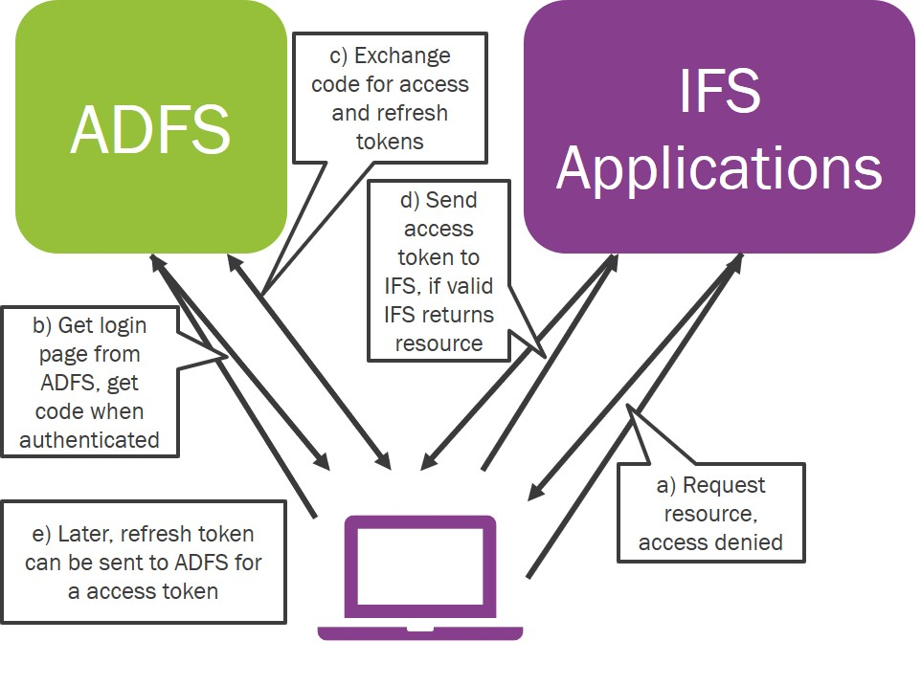
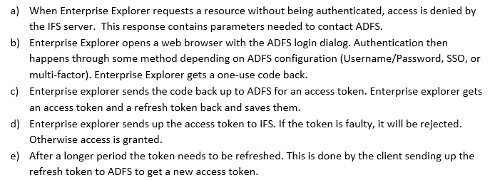
19.1
Check the following for IEE
Previous Slide
Home
IFS APP10
The user cannot log in to ADFS in the first place if the parameters sent are wrong, it might fail immediately.
If SSO or multi-factor is not correctly configured, it may also fail immediately or in the case of SSO fall back.
There is usually an error detail that can be used to check what went wrong in the ADFS logs in case it fails.
On token refresh, ADFS rejects the refresh token – indication of an ADFS issue.
Solution found
Still no Solution

Slide 49
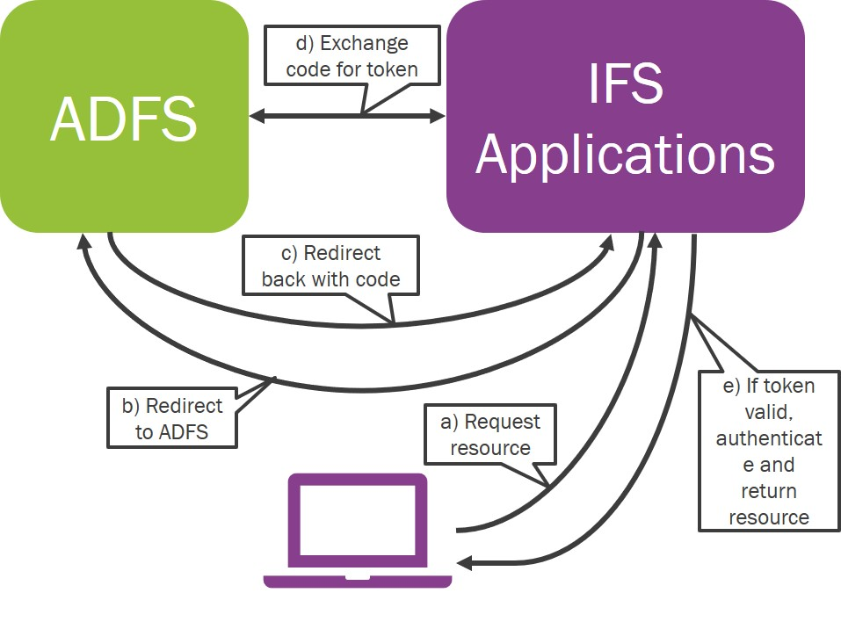
19.2
Check the following for Aurena
Previous Slide
Home
IFS APP10
The user cannot log in to ADFS in the first place if the parameters sent are wrong, it might fail immediately.
If SSO or multi-factor is not correctly configured, it may also fail immediately or in the case of SSO fall back.
There is usually an error detail that can be used to check what went wrong in the ADFS logs in case it fails.
Prompt less authentication fails in ADFS and ends up as an error sent to IFS Applications - in this case, the error could be in both the ADFS logs and maybe also in the main server logs.
Solution found
Still no Solution

Slide 50
No Solution
Previous Slide
Home
IFS APP10
Did you search in IFS Community?
Search in IFS Community
YES
NO
Search your specific issue using keywords including SSO and any error messages or log indications

Slide 51
No Solution
Previous Slide
Home
IFS APP10
Did you post this issue in IFS Community?
Post in IFS Community
YES
NO
I want to raise a Support Case since this is urgent
Did you find a solution?
YES
NO
We would appreciate if you could post this issue in IFS Community with all the details / test plan and screenshots

Slide 52
20.0
Raise a Support Case
Previous Slide
Home
IFS APP10
Provide following information with the support case
What are the configuration or installation (release/update) changes you have done prior to the occurrence of this issue?
What is the update level of the customer?
Is any error message displayed to the user?
Does authenticating to IFS Touch Apps / IFS Database Identity Provider work?
Any signs of token validation errors in the logs of any Main Server?
Do the ADFS event logs contain any errors that indicate any issues with ADFS setup?
Do clients trust the TLS certificates used by the AD and by IFS Applications?
Is the environment clustered?
Is the JVM start up argument ifs.system.url (on all main and integration servers) equal to the URL used by users to access the system?
Is the difference between the system clocks of the AD and the Middleware Server machine (all cluster nodes) lower than the “Acceptable Clock Skew” configured in the IFS MWS Admin console?
Attach following to the support case;
IFS Dump taken just after experiencing issue
Configuration of relevant application registrations in ADFS / event logs from ADFS that are suspected to be related to the issue
Output of the Get-AdfsProperties Powershell commandlet
Findings of the troubleshoot (logs and auditing)

Slide 53
Solution found
Previous Slide
Home
Thank you for using this guide to assist you in correcting your issue!
Post your feedback using following URL
https://community.ifs.com/customer-service-and-success-123/is-there-any-sso-troubleshooting-guide-for-ifs-applications-12708
Notes:
https://community.ifs.com/customer-service-and-success-123/is-there-any-sso-troubleshooting-guide-for-ifs-applications-12708

Slide 54
Thank you !
2021 - 08 - 31

